Slide 1
CSE 461
Section #7:
Getting Data from Point A to Point B

Slide 2
Packet-Switched Networks
Host B
Router
Router
Router
Router
Router
Host A
Router
Router

Slide 3
Packet-Switched Networks
What are some advantages of this?
Easy to set up and add nodes
Scales well
Partitioned data means errors are localized
Many connections possible over the same line
What are some disadvantages?
Less direct
Router processing power needed

Slide 4
Packet-Switched Networks
Host B
Router
Router
Router
Router
Router
Host A
Router
Router

Slide 5
Circuit-Switched Networks
Host B
Host Q
Host P
Host A

Slide 6
Circuit-Switched Networks
What are some advantages of this?
Easy to keep networks separate and private
Consistent response time
Quality of Service
What are some disadvantages of this?
Doesn’t scale well
Takes work to set up new circuits
Unused network capacity common

Slide 7
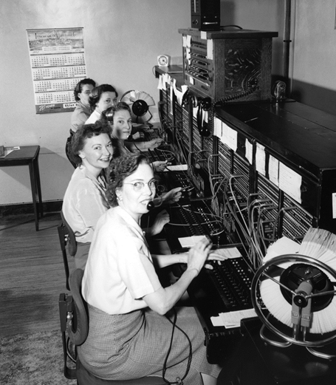
Early Circuit-Switched Network

Slide 8
Circuits in packet-switched networks?
Virtual circuits
Connection-oriented communication
Like circuits, but delivered over packets
Examples?
Tor
TCP
Multiprotocol Label Switching

Slide 9
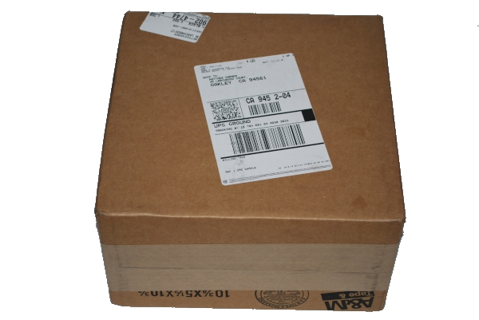
Multiprotocol Label Switching (MPLS)
Virtual circuit protocol
Developed by Cisco
For use inside networks
Works on the link layer
Labels added to link layer frames

Slide 10
MPLS Labels
Routers very quickly look at, remove, and add labels
Routing decisions using labels
Traffic class field determines QoS priority
Why do this instead of just using IP addresses?
Why is this scheme problematic?

Slide 11
QoS (Quality of Service)
Traffic can be routed according to priority
Why might we want to prioritize traffic differently?
Traffic can also be rerouted dynamically according to network conditions
Examples?
How could QoS this be a problem?

Slide 12
Net Neutrality

